Slide 1
SPOTIFY CLONE
TEAM NO-8
SUBMITTED TO - VIKAS PATEL
SUBMITTED BY -KUSH
-KUSHANK
-LALITESH
-KARTIKAY

Slide 2
Table of Contents
Introduction
What is Spotify?
Key Features
Project Highlights
Conclusion
References/Links used

Slide 3
Introduction:
We made the spotify clone where music meets innovation. Immerse yourself in a seamless audio experience as we replicate the magic of Spotify, offering a symphony of features that redefine how you groove. From personalized playlists to an extensive library, get ready to embark on a musical journey like never before. Explore, discover, and tune into the future of music streaming with our cutting-edge Spotify clone.

Slide 4
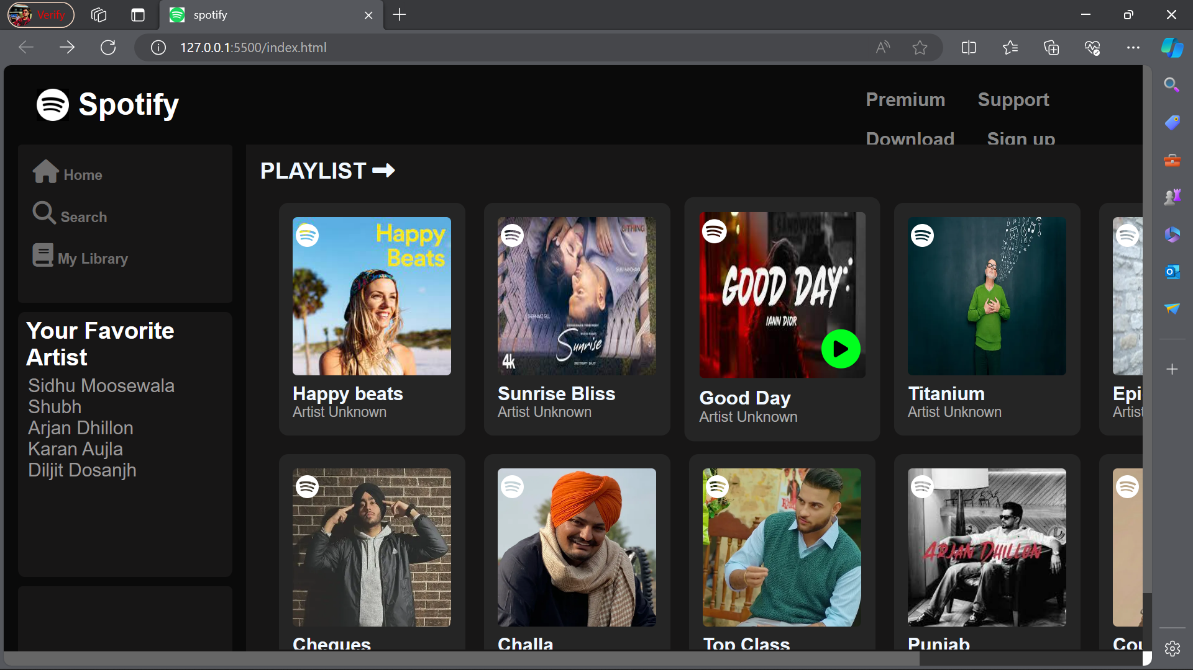
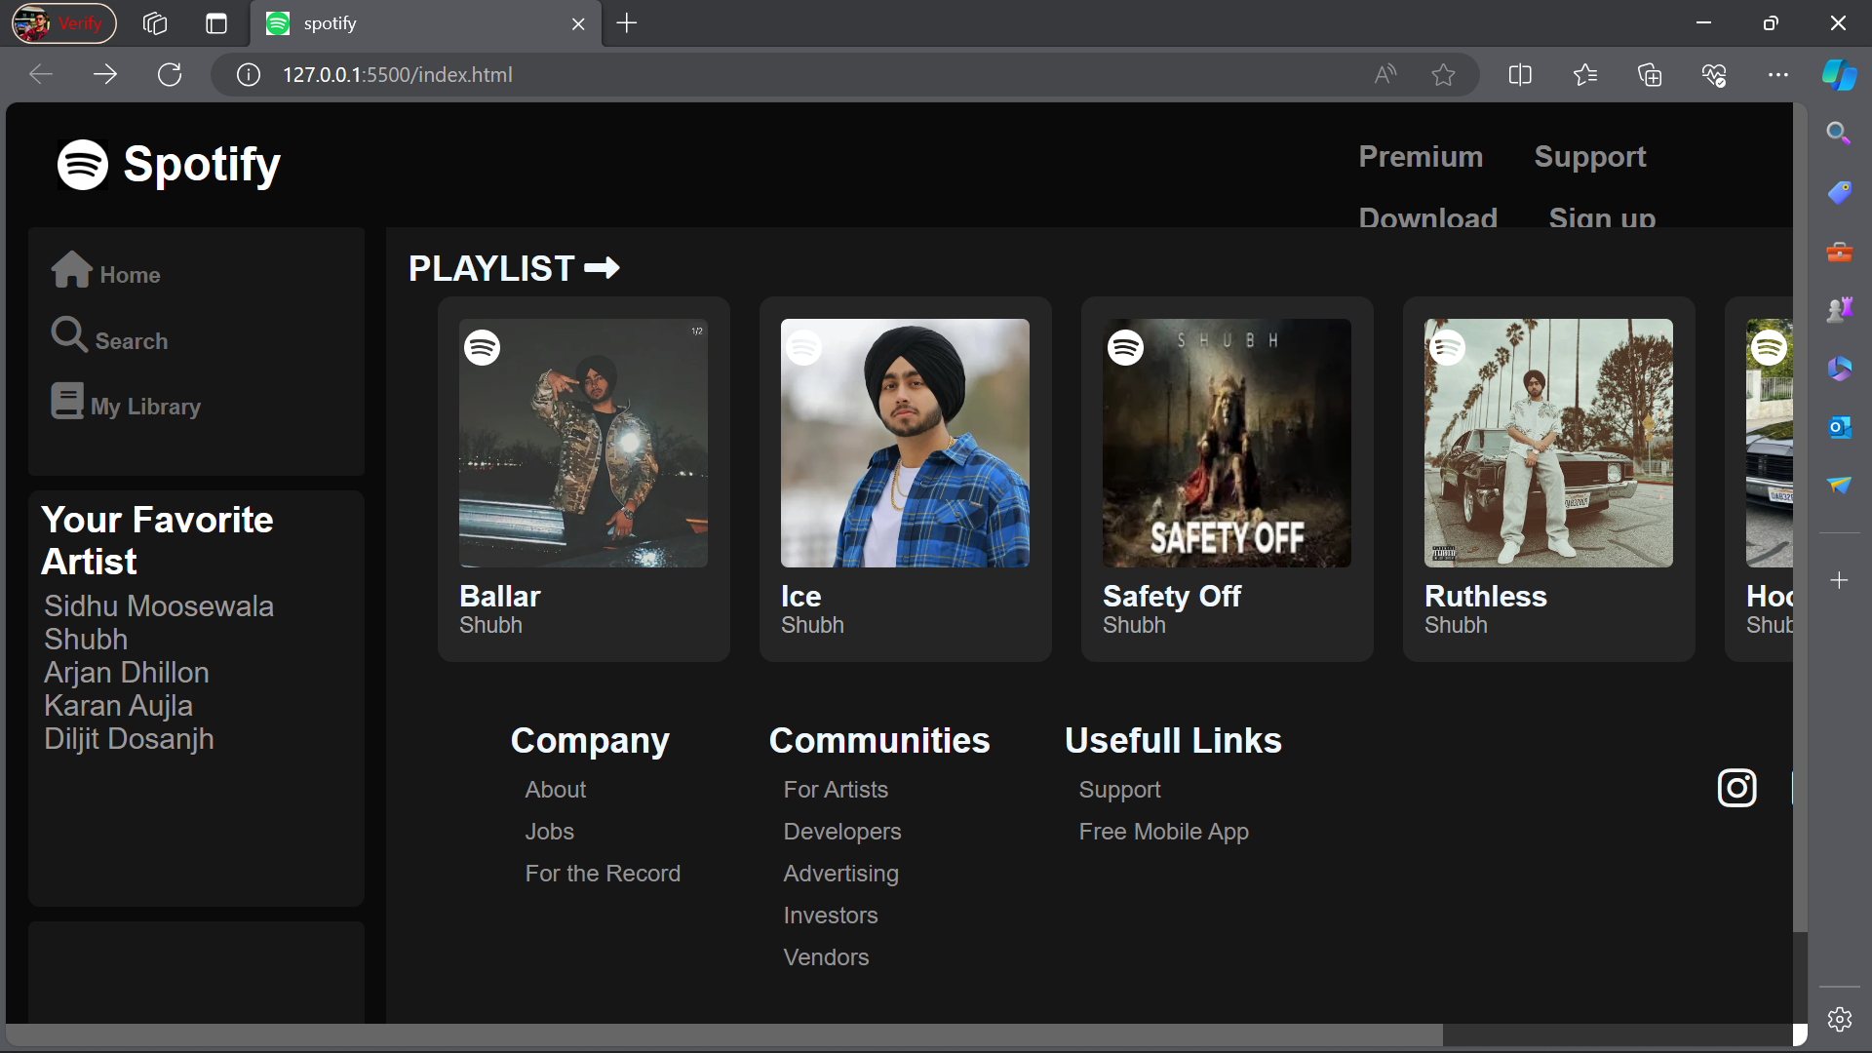
What is Spotify?
Spotify clone app is a music streaming app which provide a free plateform to listen music without downloading it.
The software is user-friendly from login to listening music. With the various features, users can enjoy listening to their favourite songs with ease.
Users will use the offline option to stream the album and listen without using the internet.
It is a freemium app also, some basic features are with adversting and limited control.

Slide 5
Key Features
Extensive Music Library: It offers a vast catalog of songs, albums, and playlists across various genres.
Personalized Playlists: The platform provides personalized playlists based on user listening habits.
Search and Browse: Users can easily search for specific songs, artists, or albums and explore new music through curated playlists and charts.
Create and Share Playlists: Users can create their own playlists, share them with friends.

Slide 6
Project Highlights
1. User-Friendly Interface
2. User Authentication
3. Audio Playback
4. Offline Access
5. Social Features
6. Security
7. Continuous Improvement and Updates

Slide 7
Conclusion
In conclusion, the Music Player project stands as a testament to the synergy between HTML, CSS, and JavaScript, showcasing their collaborative power in creating a seamless and enjoyable audio playback experience. By combining intuitive design elements with interactive functionality, this project provides a solid foundation for further customization and expansion. Happy coding and happy listening!
That's it! I hope this "Music Player Using HTML, CSS and JavaScript" will assist you on your programming journey, providing value to your current and upcoming projects.

Slide 8
References/Links used
W3Schools - https://www.w3schools.com/
CSS-Tricks - https://css-tricks.com/
Codecademy -https://www.codecademy.com/

Slide 9


